Slide 1
Generic Data Structures
Avoiding rewriting for different types

Slide 2
Strongly Typed Data Structures
Strongly typed data structure: data structure that can only hold a specific type of data, e.g.:
LinkedList that can only hold Strings
DynamicArray that can only hold ints
Strongly-typed structures are caused by specifying the only type that can be stored within the structure’s class
DynamicArray containing : int [] data
LinkedList’s Node class containing : String data
Strongly typed structures can also be caused by specifying the only type that can be taken in as a parameter or returned as a result
DynamicArray add method : public void add(int newData)
LinkedList get method: public String get(int pos)

Slide 3
Strongly Typed Structures: Pros
Strongly typed structures can be customised to exactly the behaviour you need
You know exactly what information will be in the data being stored
You know exactly what methods you can use on the data
Strongly typed structures can be reused very conveniently for hierarchies of types
All subclasses of the original type can also be stored within a strongly typed data structure*
Notes:
However, when they are RETRIEVED from the data structure, they will need to be cast back to their original types before being used fully (and you will need to confirm that they were created as the correct type before carrying out that casting) E.g.:
Person p = myLinkList.get(i);
if(p instanceof Student){
Student s = (Student) p;
System.out.println(“Student’s GPA: “ + s.getGPA());
}

Slide 4
Strongly Typed Structures: Cons
Strongly typed structures can only be used for the type (and corresponding subtypes) it was written for
Every time you want to use a Linked List for a different type, you need to write a new Linked List implementation
This can lead to a lot of code duplication

Slide 5
Moving Away From Strong Typing
How can we avoid writing strongly typed data structures?
Don’t specify the type of data stored
Don’t specify the type of data being taken as a parameter
Don’t specify the type of data being returned as a result
But we have to say SOMETHING about the data being worked with
Compiler needs to confirm that all the types are consistent
Compiler needs to confirm the types work together correctly
Essentially all we need to say is all the types match…

Slide 6
Generics – Using Type Variables
We need to set all types within a data structure to match
We want to let this type be anything* the programmer needs it to be
Solution: Set the type to be a variable
Every time we need to specify the type, use the variable instead
When the variable is finally set (i.e. when the programmer creates a data structure) every type within the class will match
Notes:
With acceptable characteristics – we’ll see more on this later

Slide 7
Generics: From the Calling Code Side
To create an ArrayList:
ArrayList<Person> myPeopleList = new ArrayList();
The angle brackets are setting the type variable for that ArrayList
When the ArrayList is created in memory, it will be set up to work with the Person class
The inner dynamic array will be : Person [] data
get() will return a Person
set() will take in a Person

Slide 8
Writing Generic Code
To write a class that uses a variable type, you must:
Set the type to a specific variable at the top of the class (using angle brackets <>)
Instead of public class LinkList, public class LinkList<E>
Store data in fields set to that variable type
E.g. instead of private int [] data, use private E [] data
Use the type variable as return / parameter types where needed
Essentially, wherever you would have written the type’s name (e.g. int, String, Person etc), use the variable you define at the top of the class
When a programmer wants to set up their structure, they specify right at the start what they need.
That step sets the type within the variable at the top of your class, which is then used throughout your class.

Slide 9
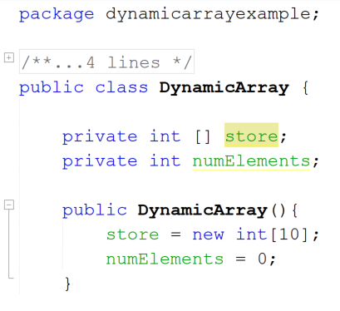
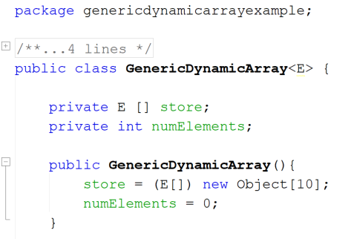
Using Strong Typing vs Using a Type Variable: Setting a Type Variable
To set a type value, add it to the end of the class signature within angle brackets

Slide 10
Using Strong Typing vs Using a Type Variable: Using a Type Variable on Fields
To create an object of the defined variable type: Use the variable name where you would use a normal class name
Special extra requirement: Can’t use new keyword with variable type, must make Object & cast back

Slide 11
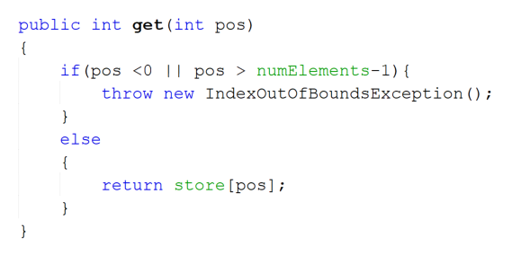
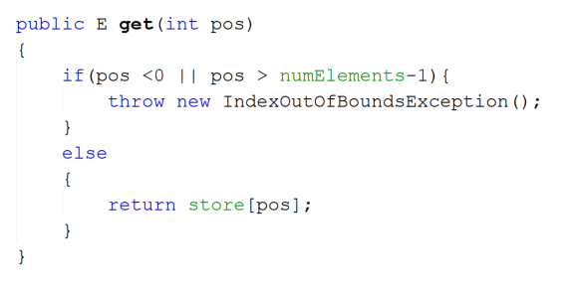
Using Strong Typing vs Using a Type Variable: Using a Type Variable as a Return Type
Setting a return value to match the generic type:
Use the name of the type variable set at the top of the class (in this case E)

Slide 12
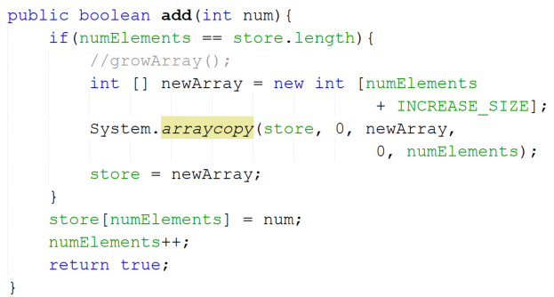
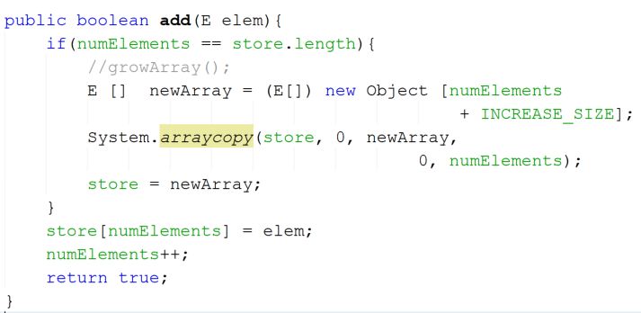
Using Strong Typing vs Using a Type Variable: Using a Type Variable as a Parameter Type
Setting a parameter value to match the generic type:
Use the name of the type variable set at the top of the class (in this case E)
Again, where you need to build a new storage object of variable type:
Create it as an Object and cast to the variable

Slide 13
The Problem With Generics
Sometimes we need our information to provide specific functionality
E.g. if we wish to be able to compare/rank two instances, their class (i.e. their type) must implement Comparable
Using a type variable on a data structure implementation allows ANY type to be accepted and worked with within that structure
What if we want to be able to sort the contents of the structure?
Solution: add a restriction/requirement to the type

Slide 14
Restricting Acceptable Types
To restrict the types that can be used in a class, specify that they must extend a specific class
Notation: <TypeVariable extends DesiredClass>
TypeVariable: The variable we’ll use throughout the data structure to indicate the type of information we’re working with
DesiredClass: The most general version of the class with functionality we need.
Any subclasses of DesiredClass will also be acceptable for use in this structure
Example: Say we want to build a linked list that can store any sort of worker so we can perform wage calculations across the entire list
Instead of: public class LinkList<E>
Use: public class LinkList<E extends Worker>

Slide 15
Restricting Acceptable Types By Interface
You can also restrict data types based on the interfaces they implement
This is particularly useful for structures that want to perform non-standard actions across their information
E.g. You can guarantee that the Comparable interface is implemented by what you’re storing, allowing you to sort the data within the structure
Implementing this restriction uses the same extends notation we saw before:
<TypeVariable extends InterfaceName<TypeVariable>>
E.g.: public class LinkList<E extends Comparable<E>>
Note: The interface is only set with the type information if that interface is also generic
Comparable is a generic interface, public interface Comparable <E>, therefore you also need to set what type of information will be compared. If this is not included, the data involved will always default back to Object
Note that you do NOT use the implements keyword!

